Slide 1




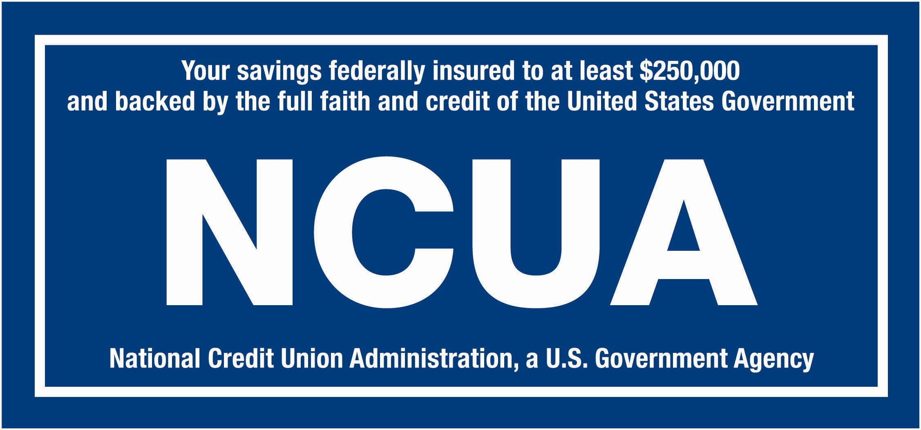
Sound reasons to become a Member
Feb 2026
Superior Service. At Sound Federal Credit Union we are committed to providing you with the highest level of personalized member service. Our knowledgeable staff will work with you to help you achieve your ﬁnancial goals.
Lower Loan Rates, Higher Deposit Rates. We pass any “proﬁts” we make directly back to our members. Because there are no shareholders to keep happy, we are able to offer some of the best rates around on loan and deposit products.
Low or No Fees. You work hard for your money. We believe you should keep what’s yours. Our “proﬁts” strengthen our credit union and beneﬁt our members. This allows us to have low fees which provides value to our members.
Local Decision Making. We live and work in this community too. You don’t have to wait for an employee in another state to make a decision about your loan or credit card. All of our decisions are made right here in our local ofﬁces.
Who can join? You can join Sound Federal Credit Union if you live, work, worship, volunteer or attend school in Fairfield, Litchfield or New Haven Counties. You can also join if an immediate family is currently a member.
How do I become a member? Apply online or stop by any of convenient branches:
888 Washington Blvd., Stamford
2200 Bedford St., Stamford
37 North Ave., Norwalk
Please bring the following items with you:
Completed and signed Member Services Agreement
Valid Driver’s License or Government Issued Photo Identification
Lending
Current rates as low as:
New auto 5.29%
  New is four years or newer
Used auto 7.29%
HELOC Prime
Signature 10.04%
Credit card 14.90%
*Sample rates as of February 1, 2026, subject to change
*APY -Annual Percentage yield
www.mysoundcu.org 203.977.4701

